Slide 1
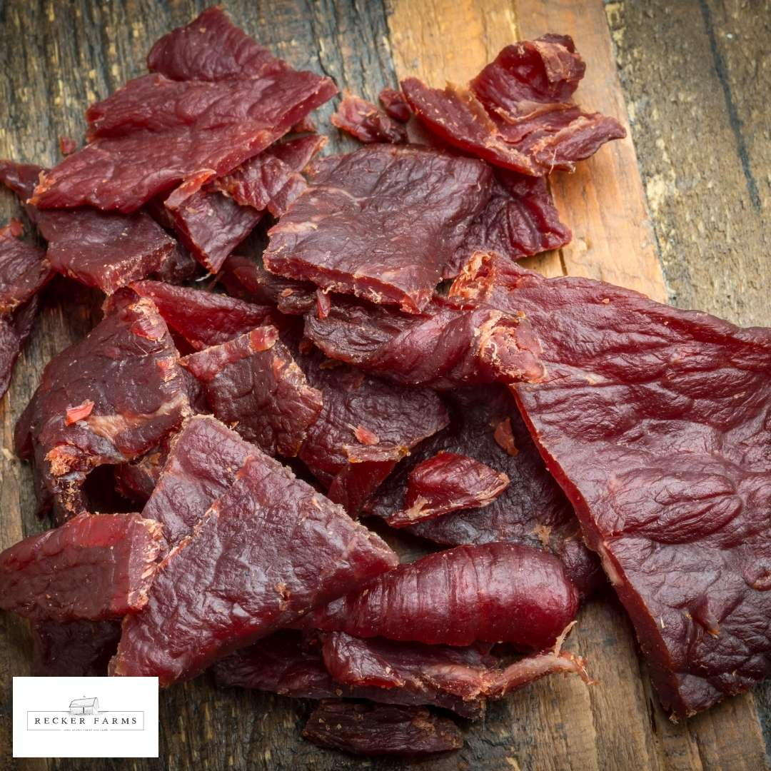

“Evaluating the survival of pathogenic bacteria in beef jerky”
Presented by-
Toma Ryan Jo

Slide 2
Background
“In recent times, the consumption of beef jerky has been linked to multiple illnesses and hospitalizations involving Escherichia coli or Salmonella and nationwide beef jerky recalls attributed to these pathogenic bacteria.”

Slide 3
Context
A study evaluated the effect of two different inoculation methods (dry and wet) on the Salmonella population in beef jerky of varying thicknesses. The beef jerky samples were divided into two main groups based on inoculation methods: Dry Inoculation and Wet Inoculation. Each of these main groups was further divided into sub-groups based on thickness: 1/4 and 1/8 inch.
The objective of the study was to determine the survival rates of Salmonella population when processed in a commercial dehydrator, as well as to assess the impact of inoculation method and thickness on the Salmonella population.

Slide 4
Context
Variables
Microbial counts
Inoculation method
2 methods: dry and wet
Thickness
2 levels: one fourth and one eighth of an inch

Slide 5
Context

Slide 6
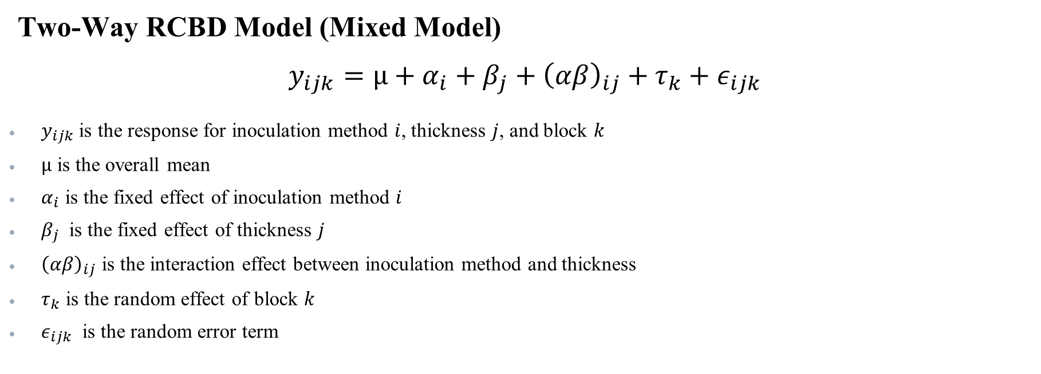
Suggested Model
Two-Way RCBD Model (Mixed Model)
$$y_{ijk}=µ+α_{i}+β_{j}+{\left(αβ\right)}_{ij}+τ_{k}+ε_{ijk}$$
$y_{ijk}$is the response for inoculation method $i$, thickness $j$, and block $k$
$µ$ is the overall mean
$α_{i}$ is the fixed effect of inoculation method $i$
$β_{j}$​ is the fixed effect of thickness $j$
${\left(αβ\right)}_{ij}$​ is the interaction effect between inoculation method and thickness
$τ_{k}$​ is the random effect of block $k$
$ε_{ijk}$ is the random error term

Slide 7
Dataset

Slide 8
References
Brown, Jessica, et al. “Inactivation of Salmonella Enterica, Escherichia Coli O157:H7, and Campylobacter Jejuni in a Restructured Beef Jerky Developed for Production in Ethiopia.” Meat and Muscle Biology, vol. 8, no. 1, 22 Apr. 2024, www.iastatedigitalpress.com/mmb/article/id/16091/, https://doi.org/10.22175/mmb.16091. Accessed 26 Sept. 2024.
“Jerky and Food Safety | Food Safety and Inspection Service.” Usda.gov, USDA, 2023, www.fsis.usda.gov/food-safety/safe-food-handling-and-preparation/meat-fish/jerky. Accessed 25 Sept. 2024.
RANDOMIZED COMPLETE BLOCK DESIGN (RCBD). North Dakota State University. https://www.ndsu.edu/faculty/horsley/RCBD_revised_notes.pdf.
“Texas Firm Recalls Beef Jerky Products due to Possible Salmonella Contamination | Food Safety and Inspection Service.” Www.fsis.usda.gov, USDA, 7 Nov. 2011, www.fsis.usda.gov/recalls-alerts/texas-firm-recalls-beef-jerky-products-due-possible-salmonella-contamination. Accessed 25 Sept. 2024.

Slide 9
Thank You! Question?

